Slide 1


2024 MUIDSI Hackathon
Sponsored by MUIDSI, IBM, and Show Me Research Week
Team#1
Isha Deol
Khawar Shehzad
Ajay Kumar

Slide 2
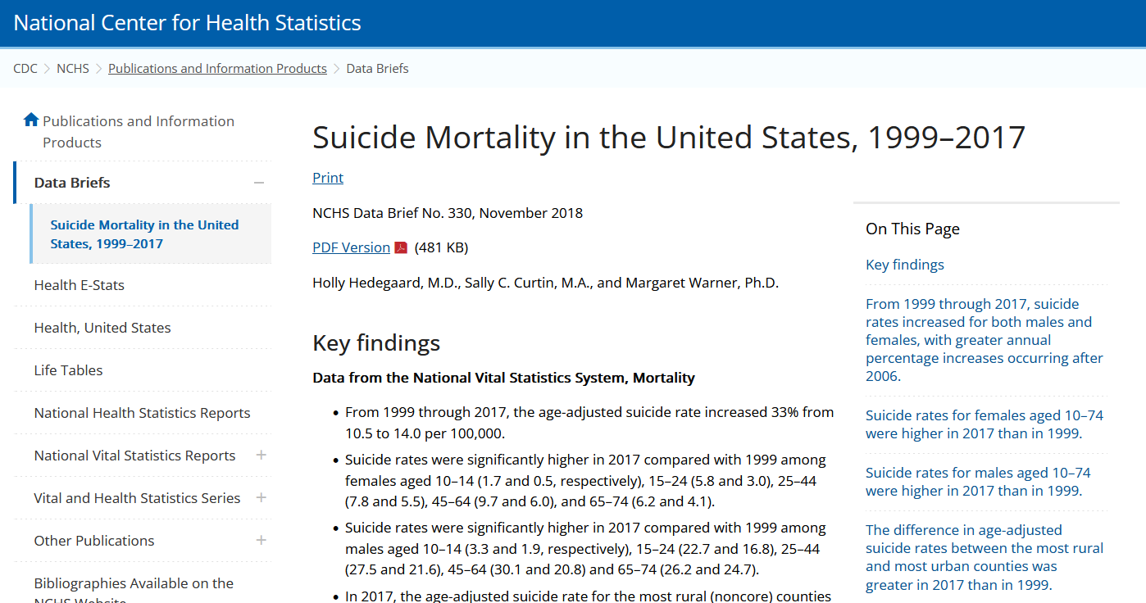
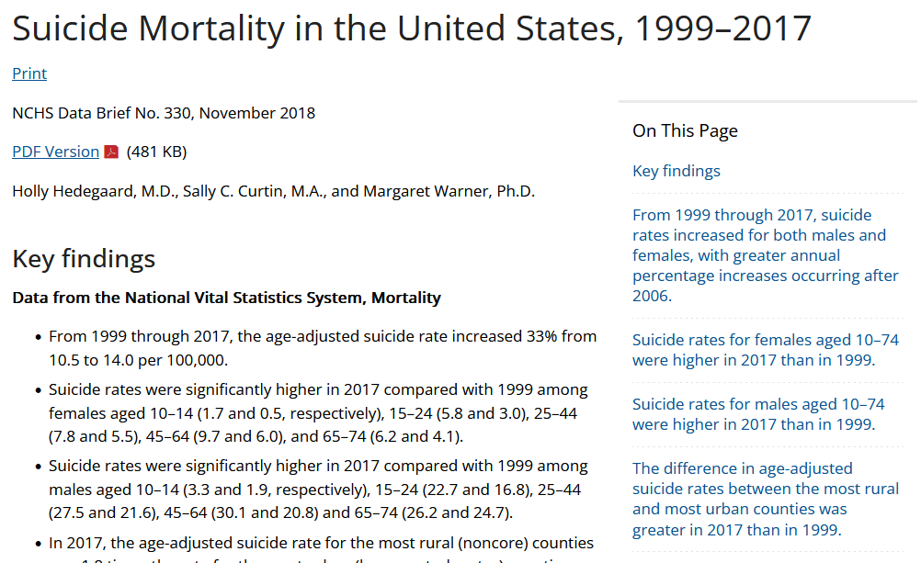

Problem Statement
Investigation to find out measures responsible for suicidal deaths in USA and comparative analysis with other countries
As per the World Health Organization (WHO), suicide deaths is a second major rising concern globally (800k suicides/year) that means one person every 40 seconds.
There are some already available studies that finds out this.
The reasons for suicide varies that why we try to find out using this dataset.
*Rising heart-attack is a first major concern.

Slide 3
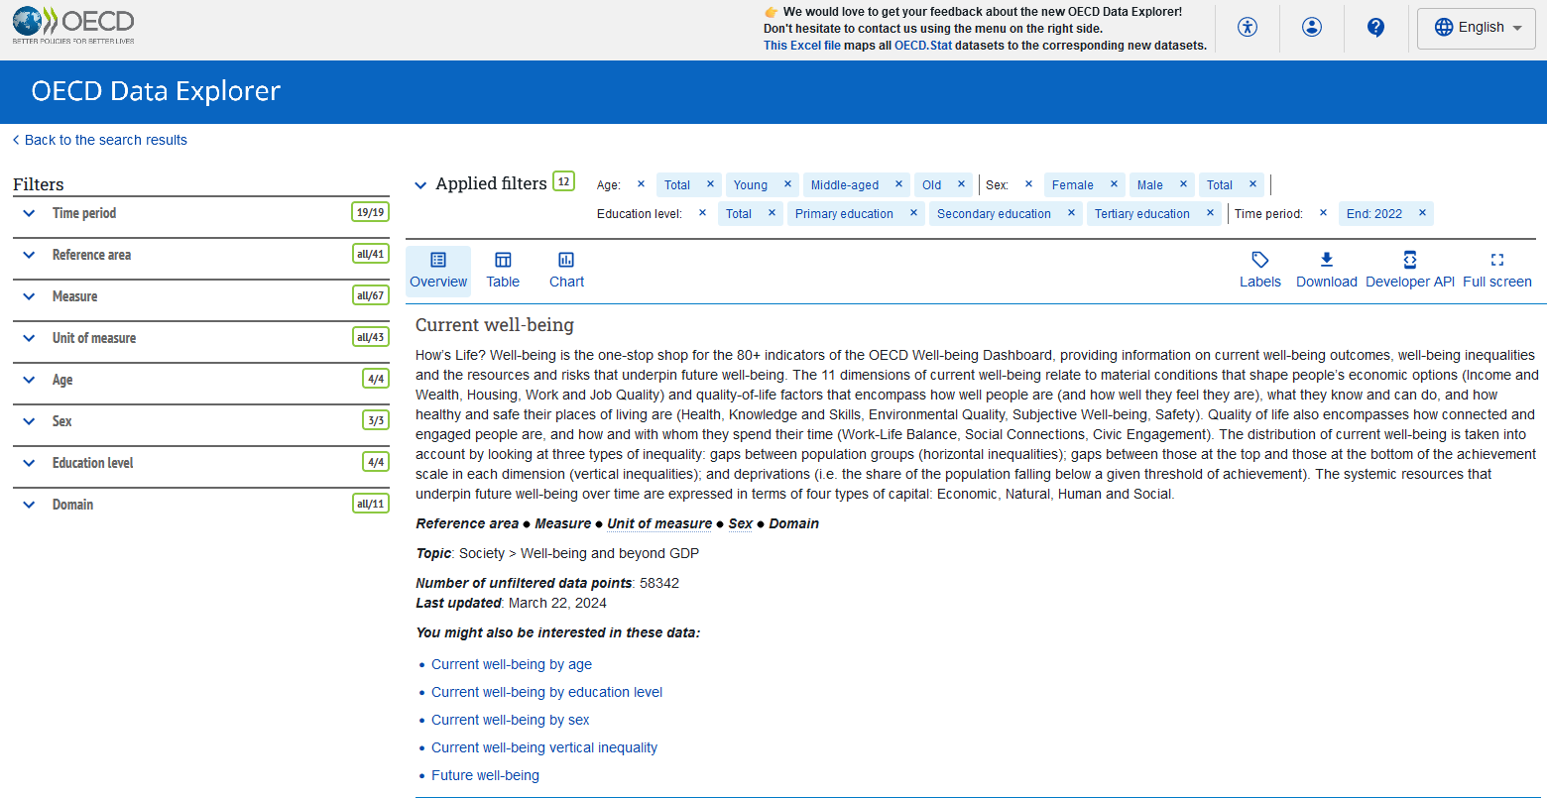
The Dataset – OECD Current Well-being
Released data accessed from: https://data-explorer.oecd.org/vis?tm=how%27s%20life%3F%20well-being&pg=0&hc[Domain]=Subjective%20well-being&snb=11&df[ds]=dsDisseminateFinalDMZ&df[id]=DSD_HSL%40DF_HSL_CWB&df[ag]=OECD.WISE.WDP&df[vs]=1.0&pd=%2C2022&dq=...OLD%2BMID%2BYOUNG%2B_T.F%2BM%2B_T.ISCED11_5T8%2BISCED11_2_3%2BISCED11_1%2B_T.&ly[rw]=REF_AREA&ly[cl]=MEASURE%2CUNIT_MEASURE&to[TIME_PERIOD]=false&vw=ov
Education level categorized as:
Primary education, Secondary education, Tertiary education and Total
Time-period ranged from 2004 to 2022
Sex has three: Male, Female and Total population observations
Reference area has 41 countries of data
Age categorized into:
Young, Middle-aged, Old and Total
measure was considered as attributes
Downloaded whole dataset
Chosen outcome: SAD_Deaths_Age:total_Sex_Total_Education_Total

Slide 4
Dataset – Processed
Input variables: 187 features considered
Life satisfaction LS
Long-term unemployment rate LTUR
Voter turnout VT
Youth not in employment, education or training NEET
Perceived health as positive PH+
Employment rate ER
Long hours in paid work LHWPW
Homicides H
Life expectancy at birth LE
Average annual gross earnings AAGE
Full-time employees earning less than two-thirds of gross median earnings FTUELT
Households and NPISHs net adjusted disposable income per capita HDI
Perceived health as negative PH
Housing affordability HA
Top earnings of full-time employees decile TEFTED
Gender wage gap GWG
Road deaths RD
Job strain JS
Exposed to air pollution EAP
Feeling safe at night FSAN
Negative affect balance NAB
Not feeling safe at night NFSAN
Lack of social support LSS
Student mathematics skills SMS
Social support SS
Student science skills SSS
Labour market insecurity LMIS
Households with internet access at home HIAH
Student reading skills SRS
Time off TO
Time spent in social interactions TSISI
Households living in overcrowded conditions HO
Poor households without access to basic sanitary facilities PHWABSF
Housing cost overburden HCO
Top wealthiest households decile TWHSD
Median net wealth MNW
Adult literacy skills ALS
Having a say in government HSG
Not having a say in government NHSG
Adult numeracy skills ANS
Top adult literacy scores decile TALS
Adults with low numeracy skills AWLNS
Adults with low literacy skills AWLLS
Top adult numeracy scores decile TANS
Household disposable income below the relative income poverty line HDBRIP
Top average household disposable income quintile TAHDIQ
Equivalised liquid financial assets below three months of the annual national relative income poverty line ELFA
Long unpaid working hours LUWH
Students with low science skills SWLSS
Top science scores decile TSSD
Students with low reading skills SWLRS
Students with low mathematics skills SWLMS
Top reading scores decile TRSD
Gender gap in working hours GGWH
Top mathematics scores decile TMSD
Output variables:
Deaths from suicide, alcohol, drugs SAD Deaths

Slide 5
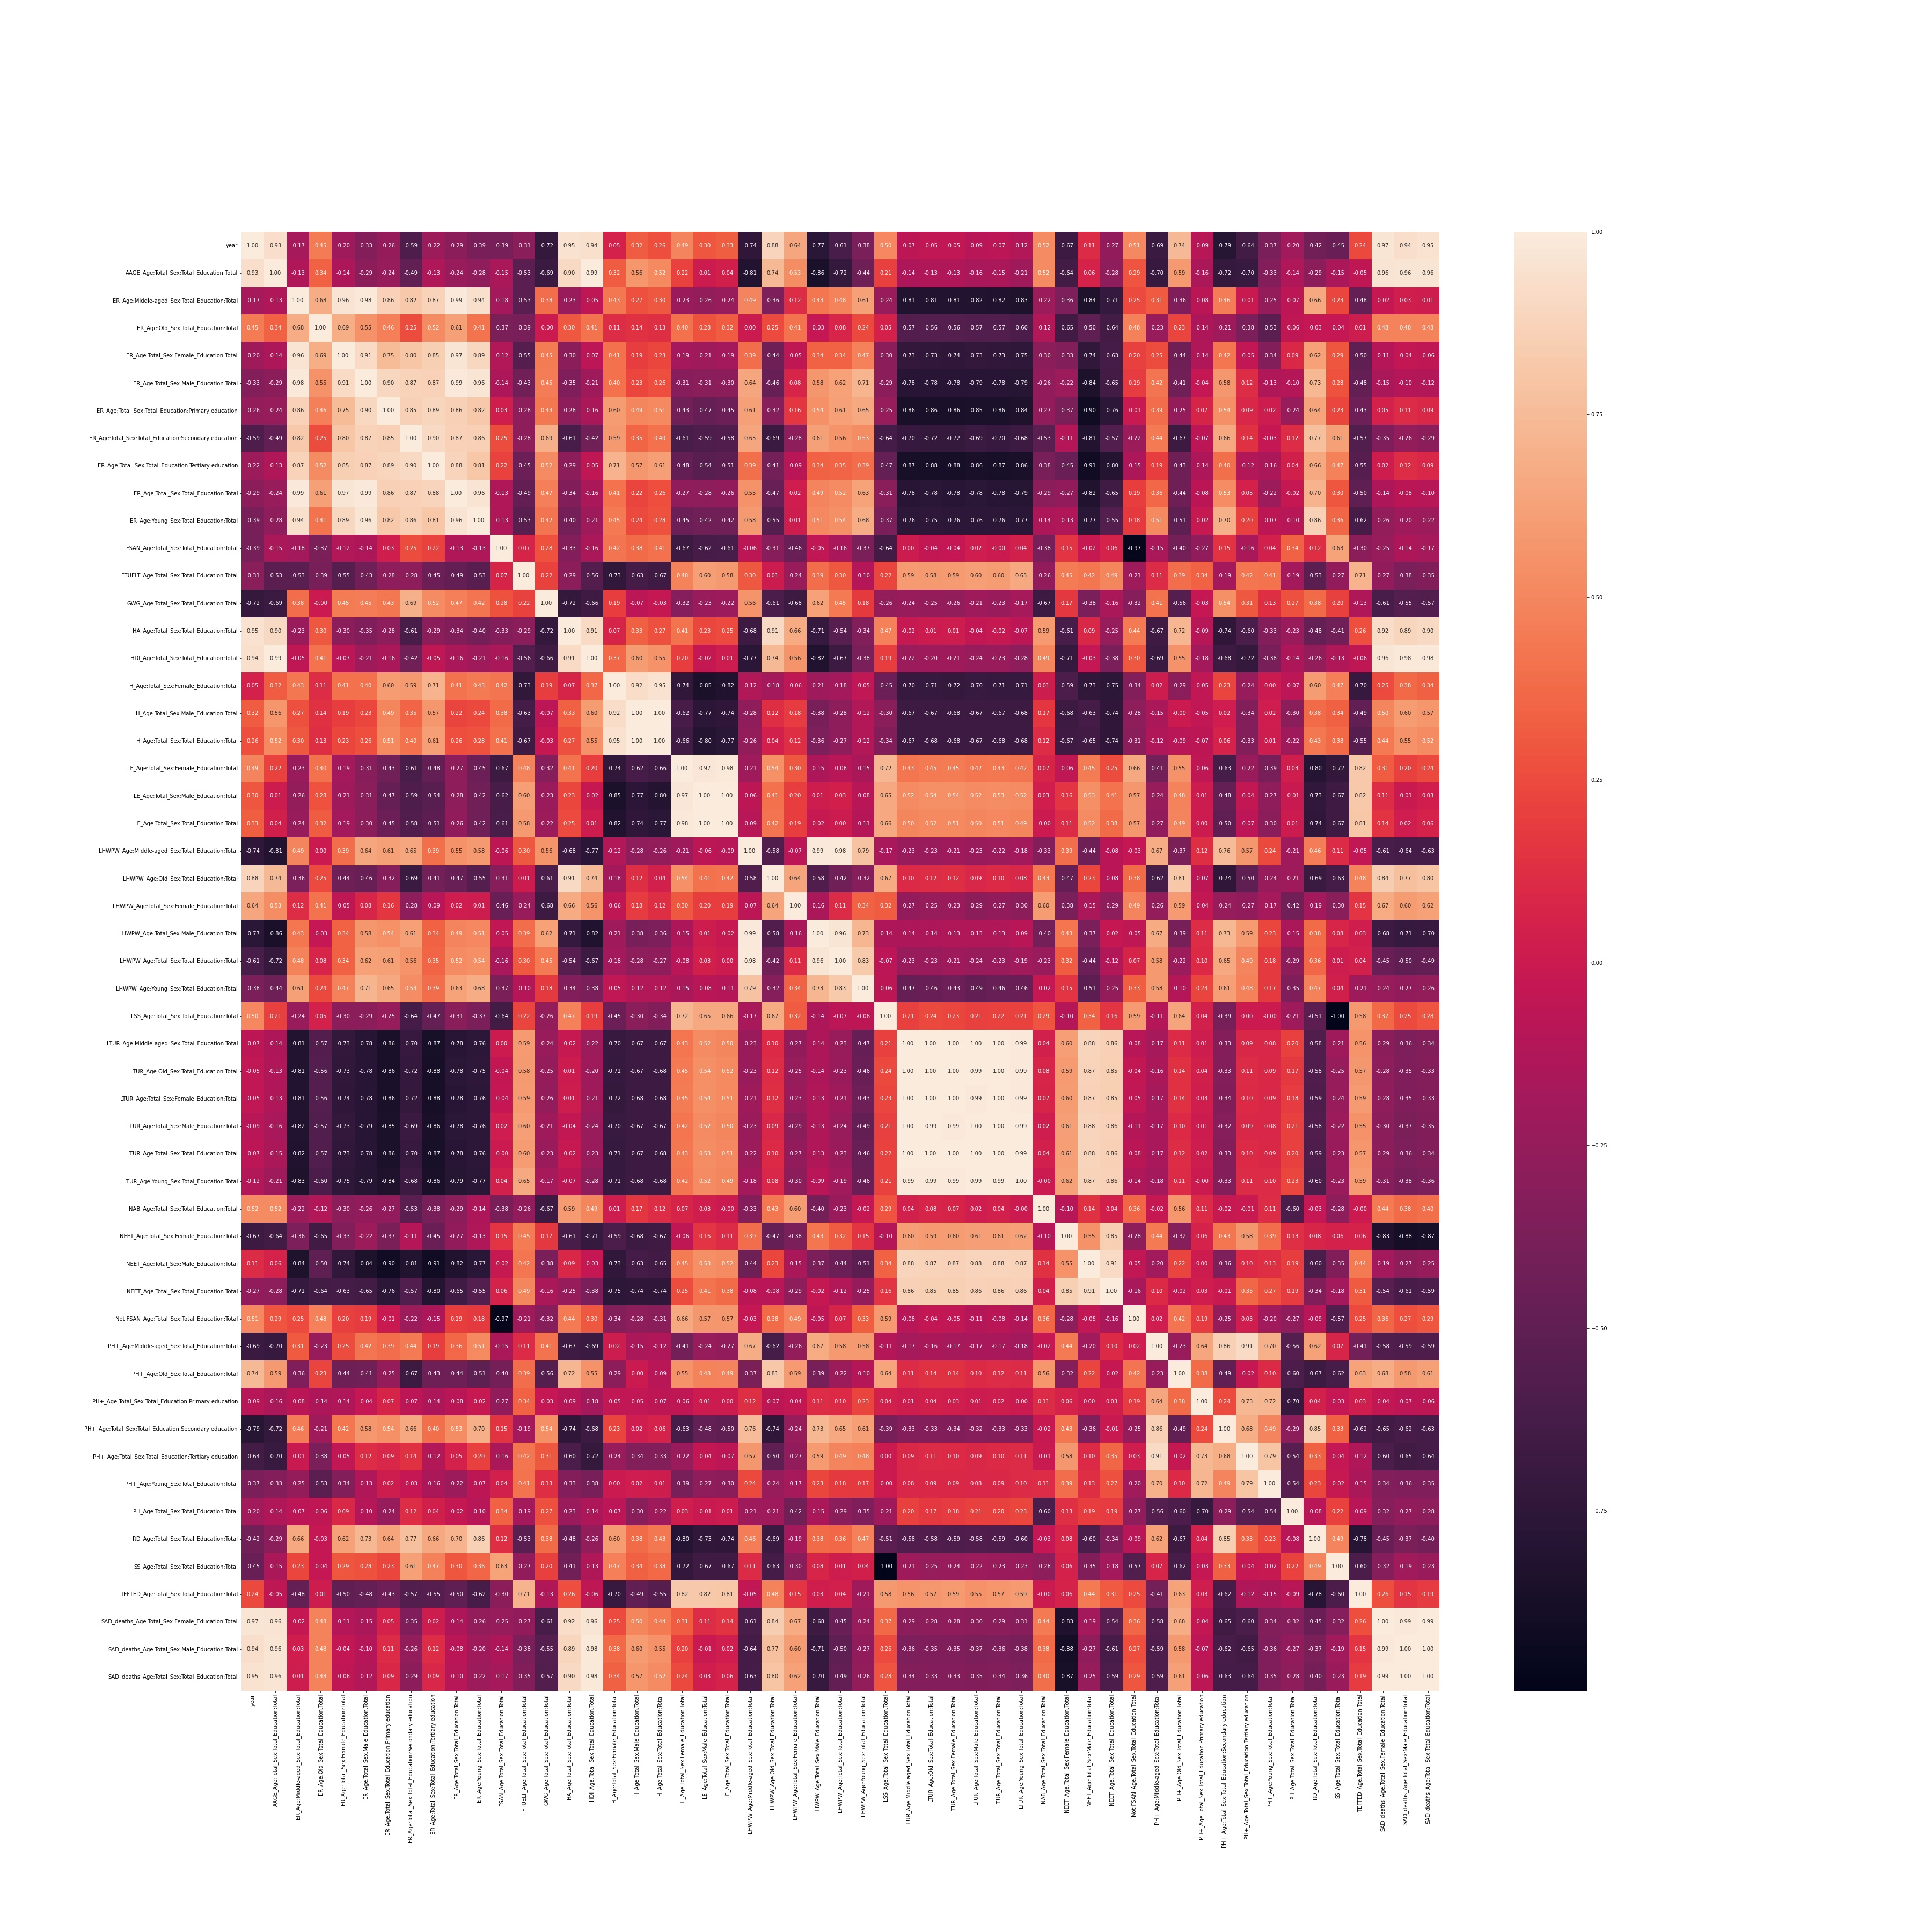
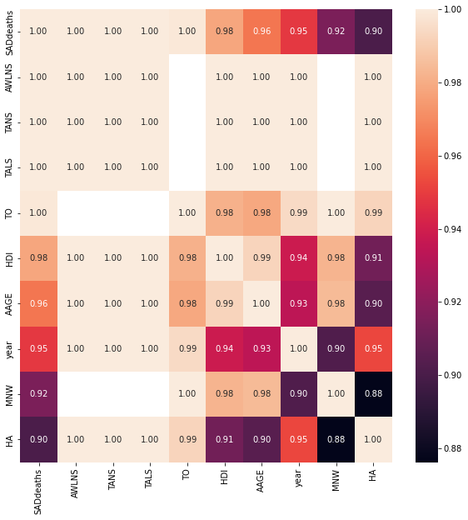
Analysis
United States
Heatmap for trimmed features
Top measures responsible for suicides in USA
AWLNS – Adults with no numerical skills
TANS – Top adult numeracy score decile
TO – Time-off
HDI – Households and NPISHs net adjusted disposable income per capita
AAGE – Annual average gross earnings
YEAR – Time period
HA – Housing Affordability
MNW – Median net wealth

Slide 6
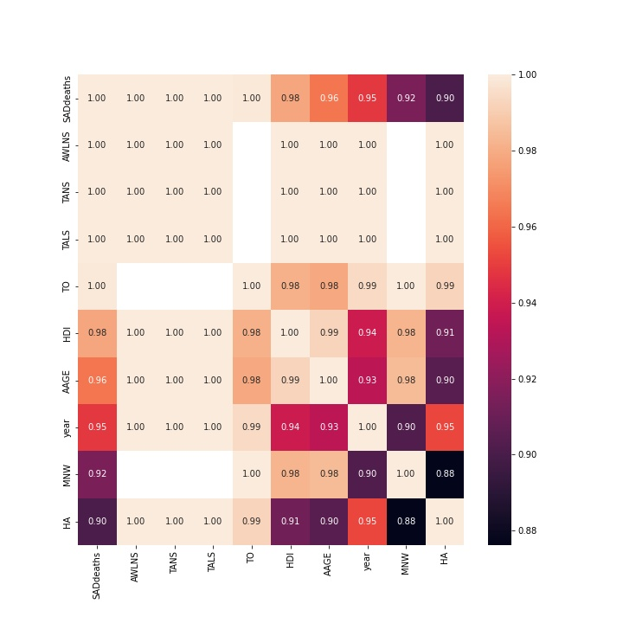
Analysis
Globally
Heatmap for trimmed features
Top measures responsible for suicides in USA
AWLNS – Adults with no numerical skills
TANS – Top adult numeracy score decile
TALS – Top adult literacy scores decile
TO – Time-off
HDI – Households and NPISHs net adjusted disposable income per capita
AAGE – Annual average gross earnings
YEAR – Time period
HA – Housing Affordability
MNW – Median net wealth

Slide 7
Analysis
For other countries,
Top measures responsible for suicides in USA
AWLNS – Adults with no numerical skills
TANS – Top adult numeracy score decile
TALS – Top adult literacy scores decile
TO – Time-off
HDI – Households and NPISHs net adjusted disposable income per capita
AAGE – Annual average gross earnings
YEAR – Time period
HA – Housing Affordability
MNW – Median net wealth

Slide 8
Analysis of Results – US Perspective
So, you’ve completed your code, what now?
After completing your model(s), you must next determine where the US stands in your outcome variable, compared to other countries
Can look at it aggregately (1 outcome per country), or longitudinally (compare outcome for each country per year)
Additionally, where does the US fall in each respective feature you’ve identified?
Hint hint: feature importance
In short: How does the US compare in prediction and outcome variables to other OECD nations?

Slide 9
Qualitative Investigation – US Perspective
Utilizing Analysis of Results to Identify Causes
At this time, your coding and analysis is done, its time to figure out the “why?”
If the US falls short in any given predictor variable, why is this?
Root cause identification
Select the 3 most important features (by your determination)
You should be able to identify research articles, programs, and news articles (amongst other sources) that might explain why the US performs more poorly in any given variable
Again, if we can identify that the US is performing poorly in a given area, but can’t explain why, then who cares?

Slide 10
Presentation of Results & Suggested Intervention(s)
Presentation Requirements
Based on your models’ results and qualitative analyses, suggest 3 interventions for the US to improve in the features you’ve identified
All information must be summarized and presented in a well-made PowerPoint
Technical Requirements
Slides must be submitted to my email (tjm4q2@umsystem.edu) by 4pm on Wednesday, 10 April 2024
Name your file your “Team_#” so that I can have them easily accessible
Please include your “Team #” as a small header or footer on all your slides so the judges can clearly see which team they are scoring
No running code during the presentation or presenting with personal laptops
If you would like to present your code for a conceptual reason, use screenshots or copy and paste it into your slides as text
At least two meaningful graphics must be included
Each team will be given 8 minutes to present and answer questions (summarize well!)
Not all team members are required to orally present, but all must be present

Slide 11
Scoring
How will judges being scoring your presentation?
70 Total Possible Points (partial points allowed)
Outcome variable selection and relevance (10 points)
Model accuracy and results (10 points)
Analysis (10 points)
Effective use of graphics (10 points)
Presentation quality, spelling/grammar, organization, etc. (10 points)
Support of qualitative investigation (10 points)
Strength of intervention recommendations (10 points)

Slide 12
Thank you!

